Slide 1

Operator’s Best Practices for Hot Water Systems in Commercial Foodservice Facilities
Notes:
Hello and welcome to the operator’s best practices for hot water systems in commercial foodservice facilities.
Hola y bienvenido a esta presentación de las mejores prácticas del operador para sistemas de agua caliente en instalaciones de servicios de alimentos comerciales.

Slide 2
Use this button to access the voiceover:
Notes:
There will be a speaker icon on every slide that will start playing the voiceover.

Slide 3
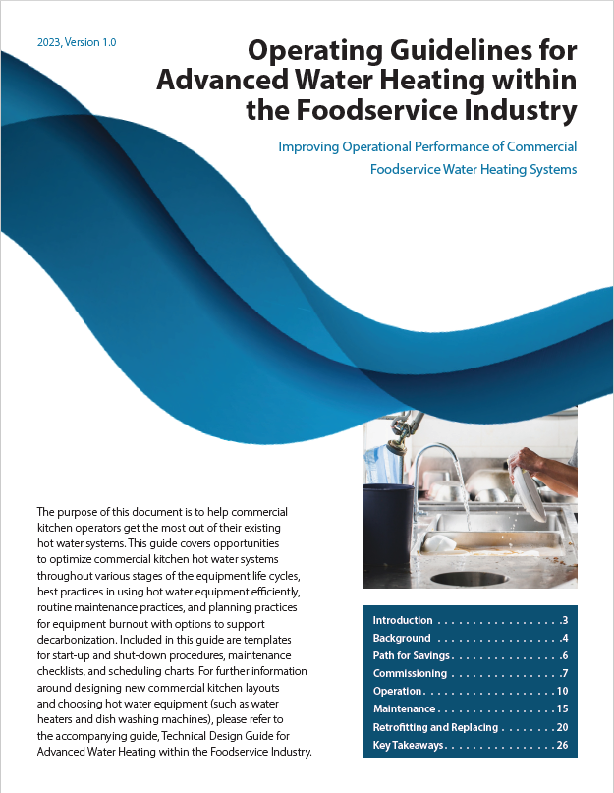


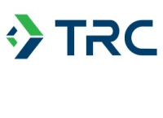

The information in this presentation can be found in a new design guide, accessible at https://caenergywise.com/design-guides/
This most recent revision was made possible with funds from the CalNEXT program by a team of energy industry professionals from TRC and Frontier Energy.
Notes:
The information found in this presentation is a distillation of lessons learned from multiple laboratory, field and industry characterization studies performed for the commercial foodservice industry.
These lessons have been compiled into a new operator’s guide for advanced water heating within the foodservice industry by a team of energy industry professionals from TRC and Frontier Energy. This was made possible with funds from the CalNEXT program.
La información encontrada en esta presentación son los partes más importantes de múltiples estudios de caracterización de laboratorio, campo e industria realizados para la industria de servicios de alimentos.
Estas lecciones se han compilado en una nueva guía de diseño para sistemas avanzados de calentamiento de agua en la industria de servicios de alimentos por un equipo de profesionales de la industria energética de TRC y Frontier Energy. Este documento es accesible en el enlace de esta diapositiva y proporciona más detalles que esta presentación.
Esto fue posible gracias a los fondos del programa CalNEXT.

Slide 4

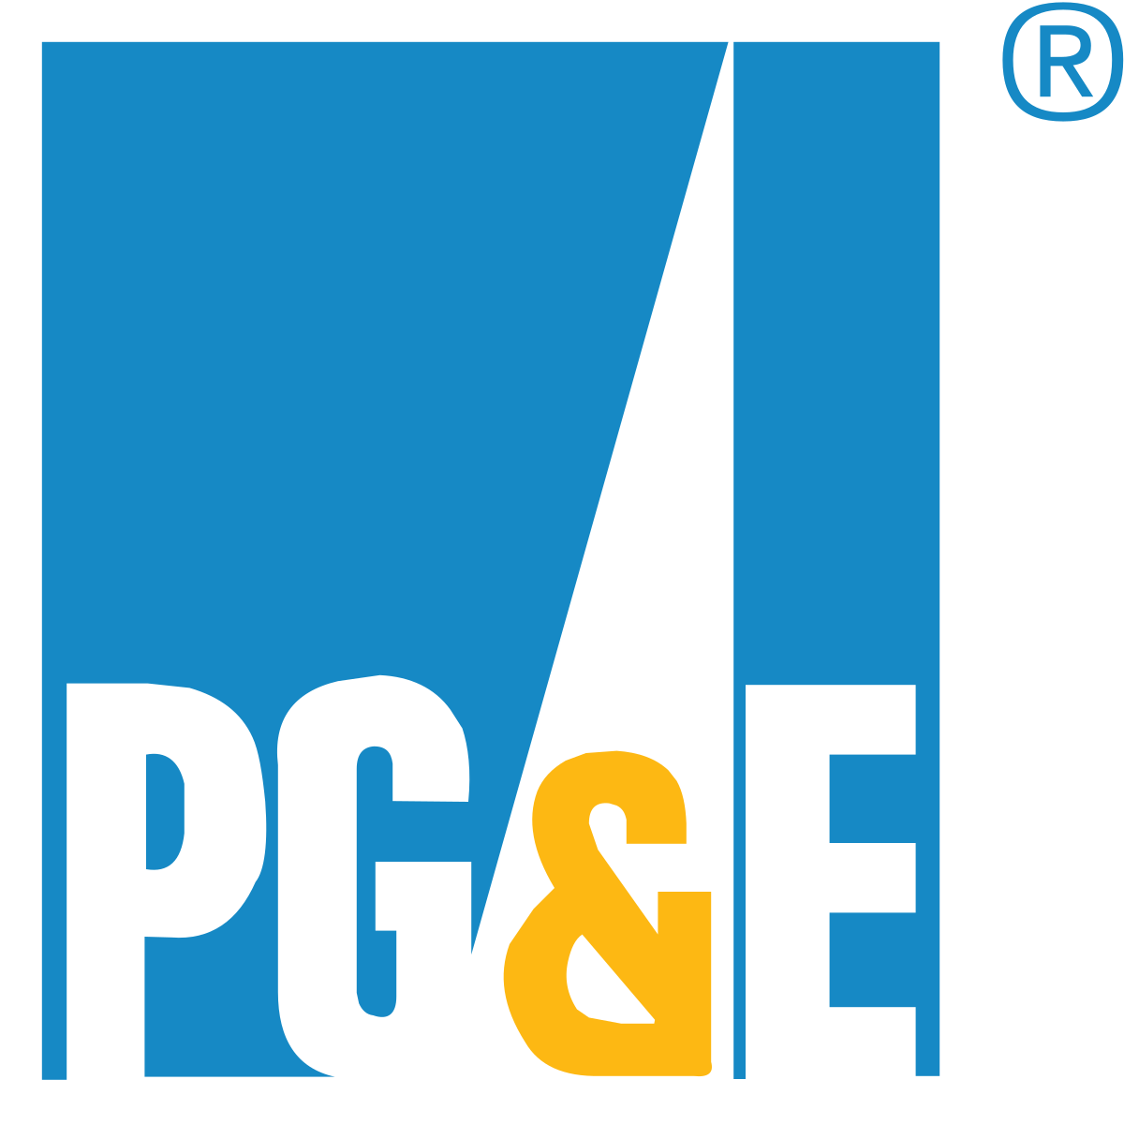
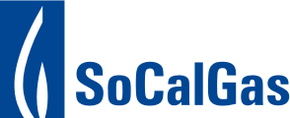
Design Guide History
This 2023 design guide builds from previous iterations. The first design guide was published in 2010, and was funded by PG&E and the California Energy Commission.
The second revision of this design guide was first published in 2021 with funds from SoCalGas.

Slide 5
Learning Goals
Viewers will be able to:
Describe the water and energy savings associated with proper system performance
Understand when to replace equipment
Understand how to design an effective staff training program
Notes:
By the end of this presentation, viewers will be able to:
Describe the water and energy savings associated with proper system performance
Understand when to replace equipment
And understand how to design an effective staff training program.

Slide 6

Primary Resource
CAEnergyWise.com
CALIFORNIA
ENERGY WISE
Notes:
This presentation and the design guide can both be found at the California energy wise dot com website. This website also has other resources for foodservice and energy industry professionals.

Slide 7




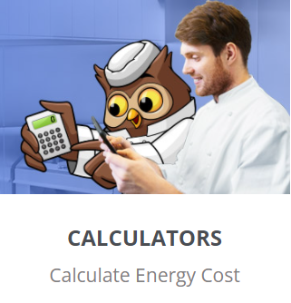
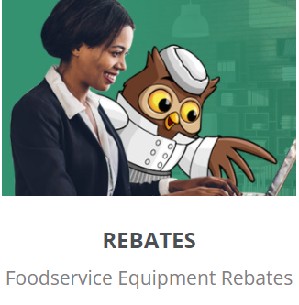
CALIFORNIA
ENERGY WISE
CAEnergyWise.com
Notes:
The California Energy Wise website includes directions for energy surveys to help foodservice operators understand their energy use,
Design guides to help facility designers design more energy efficient kitchens,
Links to upcoming in-person and virtual seminars as well as recordings from previous seminars which contain tips on best operating and design practices as well as results from lab and field studies,
Instructions on how to participate in Frontier Energy’s try before you buy program, which allows foodservice operators to test-drive new cooking equipment,
Calculators to help compare the energy and cost impacts of different pieces of kitchen equipment,
And information about how to access rebates for foodservice equipment.
El sitio web de California Energy Wise incluye instrucciones para encuestas que ayudan a los operadores de servicios de alimentos a comprender su consumo de energía,
Guías de diseño para ayudar a los diseñadores de instalaciones a crear cocinas más eficientes en energía,
Enlaces a seminarios, presenciales virtuales con grabaciones de seminarios anteriores que contienen consejos sobre las mejores prácticas operativas y de diseño, y resultados de estudios de laboratorio y campo,
Instrucciones sobre cómo participar en el programa de “prueba antes de comprar” de Frontier Energy, que permite a los operadores de servicios de alimentos probar nuevos equipos de cocina,
Calculadoras para ayudar a comparar el impacto en la energía y los costos de diferentes equipos de cocina,
Y información sobre cómo acceder a reembolsos para equipos de servicios de alimentos.

Slide 8
Section 0: Preamble
Notes:
Section 0: Preamble

Slide 9
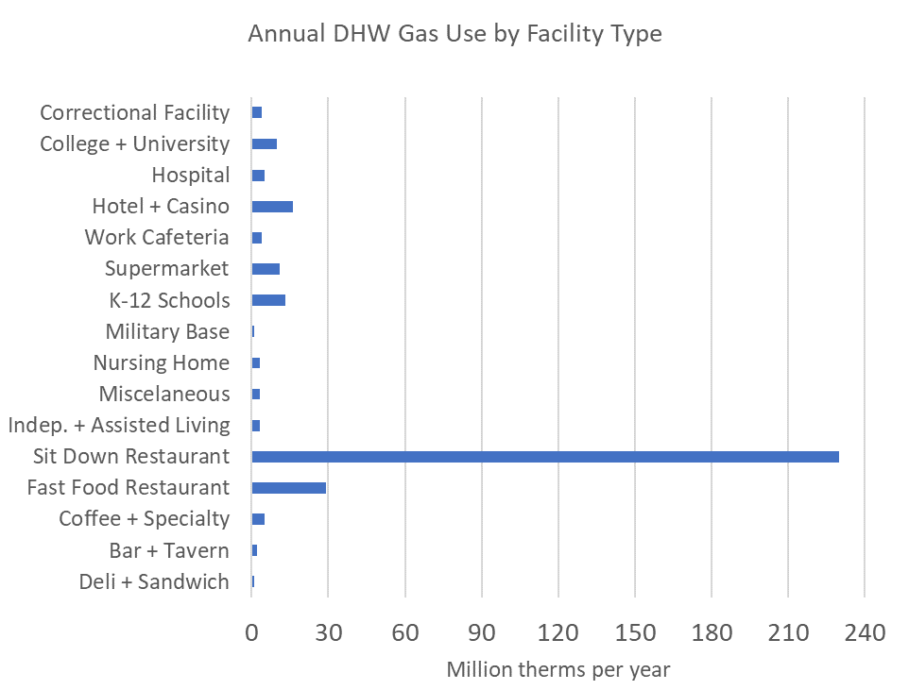
Why do we care about hot water systems?
Hot water is the lifeblood of restaurants
  Clean Hands
  Wash dishes and equipment
  Cook food
Health department regulations
Highly energy intensive
  340 MTherms/year – 16% of commercial gas usage statewide
Source: 2010 CEC Report by Fisher-Nickel Inc. https://hdl.handle.net/2027/uc1.31822039658588
Notes:
Why do we care about hot water systems? Hot water is critically important to commercial foodservice facilities because it provides most of the sanitation. Hot water is the lifeblood of restaurants because without it, operators cannot clean their hands, wash dishes and equipment or cook food. Hot water touches virtually every part of the commercial foodservice facility.
Health department regulations basically say that you can’t run a restaurant without adequate hot water delivery for fear of getting people sick.
Hot water systems are highly energy intensive. In California they use 340 megatherms per year which accounts for 16% of all commercial gas usage statewide. Hot water systems can account for as much as half of a facility’s gas usage, so hot water systems are important for a facility’s bottom line as well as for its operation.

Slide 10
Utility Rates
Current CA Utility Rates
(Dec. 2023)
Water and Wastewater Cost | $14.16 | /HCF
Gas Rate | $1.65 | /therm
Electricity Rate | $0.33 | /kWh
Notes:
Make sure you provide utility rate info upfront once and all tables are updated to those costs throughout. It is important to have a slide that acknowledges the rates possibly placed near the beginning or before the primary water heater comparison table. The rates slide needs to show that rates for water, energy and gas are going up as a trend over the last x years., 2nd key point is that they are going up for electricity faster than for gas, which represents a challenge 5.8 ratio, used to be 3.5 when I started. This has implications on payback as California decarbonizes. I provided the updated rates and we should use those. Its going to get worst next year, PG&E just announced 13% electric rate increases, thus best that this design guide is not outdated from day 1, even if we have to talk to the reality that payback is long or non-existent and it changed significantly even during the duration of this project.
Asegúrate de proporcionar información sobre las tarifas de servicios públicos, y actualiza todas las tablas con esos costos. Es importante tener una diapositiva que reconozca las tarifas, posiblemente colocada al principio o antes de la tabla principal de comparación de calentadores de agua. La diapositiva de tarifas debe mostrar que las tarifas de agua, energía y gas han estado aumentando como una tendencia en los últimos X años. El segundo punto es que la electricidad está subiendo más rápido que el gas, lo que representa un desafío con una proporción de 5.8, que fue 3.5 cuando empecé. Esto tiene implicaciones en el retorno de la inversión a medida que California descarboniza. Proporcioné las tarifas actualizadas y debemos usar esas. Va a empeorar el próximo año; PG&E acaba de anunciar aumentos de tarifas eléctricas del 13%, por lo que es mejor que esta guía de diseño no esté desactualizada desde el primer día, incluso si tenemos que hablar sobre la realidad de que el retorno de la inversión es largo o inexistente y ha cambiado significativamente incluso durante la duración de este proyecto.

Slide 11
Cost Impacts of Water and Energy Efficiency and Operating Patterns
Restaurant | Dishmachine Age (yr) | # Meals Served | Hot Water Use (gal) | Gas Use (therm) | Electricity Use (kWh) | Utility Cost ($/day) | Cost per Meal
A | 3 | 503 | 674 | 9.8 | 150 | $85.42 | $0.17
B | >5 | 495 | 1031 | 14.7 | 183 | $121.48 | $0.25
Meal Service | # Meals Served | Hot Water Use (gal) | Gas Use (therm) | Electricity Use (kWh) | Utility Cost ($/day) | % Savings (Thursday/Wednesday) | Cost per Meal
Wednesday Dinner | 405 | 1129 | 13.1 | 132 | $96.75 |  | $0.24
Thursday Dinner | 412 | 488 | 5.6 | 107 | $61.22 | 37% | $0.15
Notes:
These tables compare the cost impacts of water and energy efficiency and operating patterns. The first table compares two hot water systems. System A is a fairly efficient hot water system and system B is a fairly inefficient hot water system. Restaurant A’s dishmachine is only 3 years old whereas restaurant B’s dishmachine is more than 5 years old and has some significant operating problems. Both restaurants serve about 500 meals per day, but restaurant B uses almost double the amount of hot water because it’s using substantially less efficient fixtures. Similarly, restaurant B uses about one and a half times as much gas as restaurant A does. Restaurant A uses less electricity than restaurant B. This adds up such that restaurant A is paying 17 cents per meal for hot water usage and restaurant B is paying 25 cents per meal for hot water usage.
The second table compares the same restaurant during a dinner service on Wednesday and a dinner service on Thursday. It compares the impact of operating patterns on energy usage. For each service, the restaurant served roughly the same number of meals. However during Wednesday’s dinner, the staff wasn’t using the equipment as designed and used almost triple the amount of hot water as was needed for Thursday’s dinner. That led to the cost per meal for Wednesday being 24 cents per meal whereas on Thursday it was only 15 cents per meal. The only thing that changed between these two rows on this table was the staff and how well trained they were.

Slide 12
Operator’s Path for Savings
1. Commission new equipment and systems properly
2. Operate systems efficiently
2. Train Staff Well
3. Maintain systems and specify preventative maintenance
4. Specify efficient equipment for replacing on burnout or pre-burnout retrofit
Notes:
This is the operator’s path for savings. Step one is to commission new equipment and systems properly because if it isn’t installed correctly, it will never work correctly. Step two is to operate systems efficiently and to train staff on how to use each piece of equipment as designed. Step three is to maintain systems and to specify preventative maintenance. This means creating a maintenance schedule to ensure that each piece of equipment is operating as designed. Step four is to specify efficient equipment for replacing on burnout and creating an equipment replacement schedule.

Slide 13
Section 1: Commissioning
Notes:
Section 1: Commissioning

Slide 14
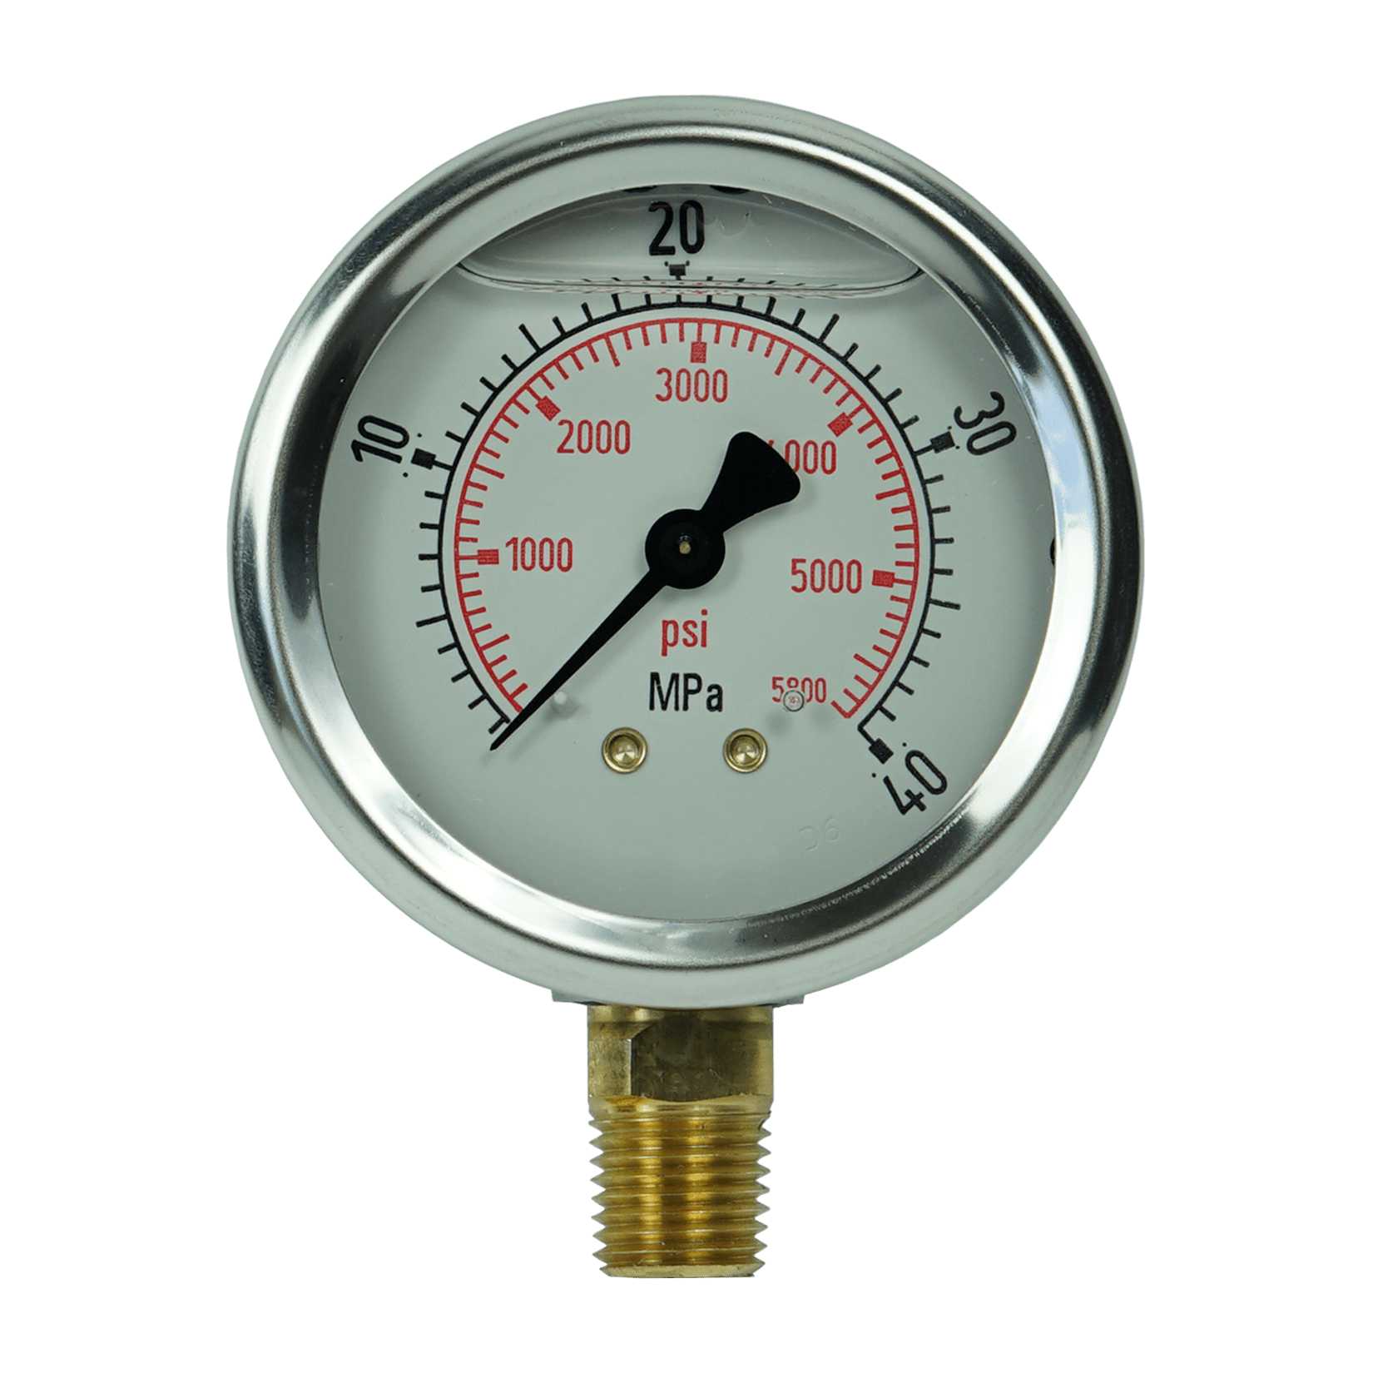
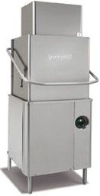
Commissioning a Dishmachine
Commissioner should check:
Tank Temp
Rinse Temp
Inlet Hot Water Temp
Inlet Cold Water Temp
Exhaust Flow Rate
Rinse Pressure
Input Hot Water Pressure
Input Voltage and Amperage
Rinse water consumption
Chemical Consumption
Notes:
Tank temperatures can range from 120 to 150 degrees Fahrenheit and need to be checked to ensure the functioning of the tank’s drain system and temperature control.
The rinse temperature of high temperature rinse machines should be 180 and the rinse temperature of low temperature rinse machines should be about 140 depending on the chemical supplier. This is important for high temperature machines because the 180 degree water is needed for sanitation. For low temperature dishmachines, the temperature is needed to activate the sanitizing aid chemical.
The inlet hot temperature needs to be checked for high temperature machines to ensure that the booster heater only has to work to its allowable limits and to ensure that the rinse temperature is always met. The inlet hot water temperature is the same as the rinse temperature for low temperature rinse dishmachines.
The inlet cold water temperature needs to be checked for heat recovery dishmachines because the ventless function of heat recovery machines can sometimes be compromised by inlet cold water temperatures over about 80 degrees.
The exhaust flow rate needs to be matched to the exhaust fan speed for adequate ventilation of the dishroom.
Las temperaturas del tanque pueden oscilar entre 120 y 150 grados Fahrenheit y deben verificarse para garantizar el funcionamiento del sistema de drenaje y control de temperatura del tanque.
La temperatura de enjuague de las máquinas de enjuague de alta temperatura debe ser de 180 grados y la temperatura de enjuague de las máquinas de enjuague de baja temperatura debe ser de aproximadamente 140, según el proveedor de productos químicos. Esto es crucial para las máquinas de alta temperatura, ya que se necesita agua a 180 grados para la desinfección. Para lavavajillas de baja temperatura, la temperatura es necesaria para activar el producto químico auxiliar desinfectante.
La temperatura del agua caliente de entrada debe verificarse en las máquinas de alta temperatura para garantizar que el calentador auxiliar solo tenga que funcionar dentro de sus límites permitidos y para garantizar que la temperatura de enjuague siempre se cumpla. La temperatura del agua caliente de entrada es la misma que la temperatura de enjuague para lavavajillas de enjuague de baja temperatura.
La temperatura del agua fría de entrada debe verificarse en lavavajillas de recuperación de calor porque la función sin ventilación de las máquinas de recuperación de calor a veces puede comprometerse con temperaturas de agua fría de entrada superiores a aproximadamente 80 grados.
La tasa de flujo de escape debe coincidir con la velocidad del ventilador de escape para una ventilación adecuada del cuarto de lavado de platos.

Slide 15
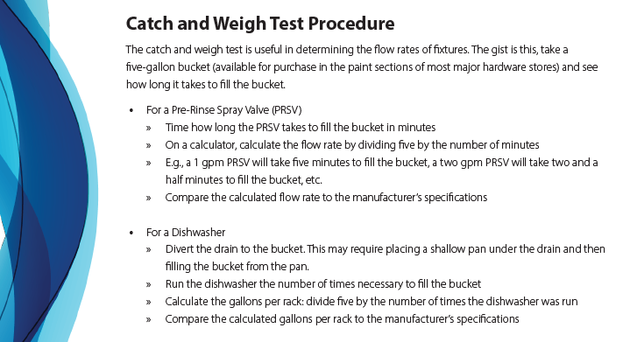
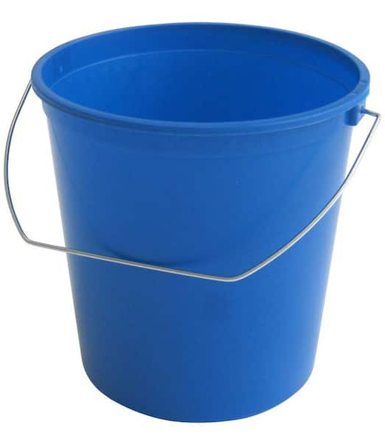
Notes:
The catch and weigh test is a useful method of determining the flow rate of fixtures and is an important part of commissioning a new hot water system or installing new fixtures. This test is performed by measuring the amount of time it takes to fill a five gallon bucket with a fixture. Example procedures for pre-rinse spray valves and dishwashers are included here.
La prueba de “captura y peso” es un método útil para determinar la tasa de flujo de los accesorios y es una parte importante de la puesta en marcha de un nuevo sistema de agua caliente o la instalación de nuevos accesorios. Esta prueba se realiza midiendo el tiempo que tarda en llenarse un cubo de cinco galones con un accesorio. Se incluyen aquí procedimientos de ejemplo para las válvulas de rociado de prelavado y lavavajillas.

Slide 16
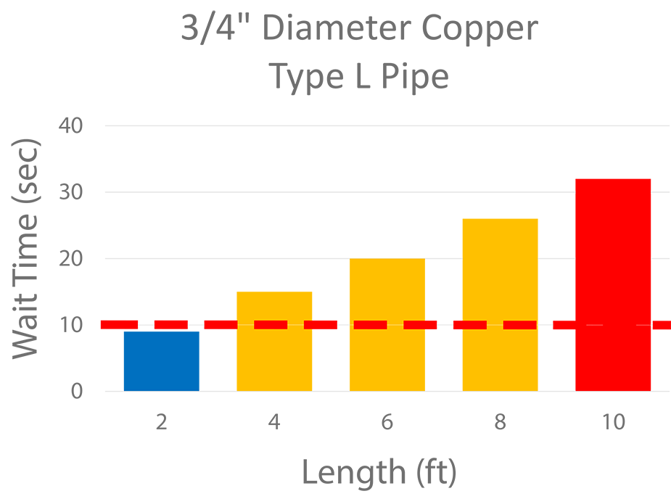
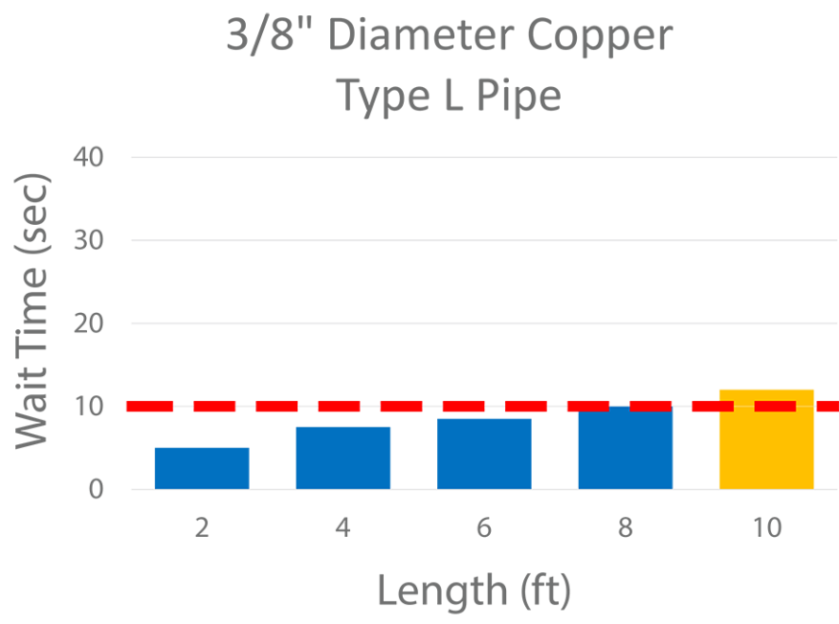
Commissioning a new Hot Water System
Adequate hot water delivery at all fixtures
Record wait times at lavatory hand sinks
Record water temperature at major points of use
Record wait times at any remote fixture
Check operating flow rates at all fixtures
Operate two biggest flow rate fixtures simultaneously
Notes:
Here are some best practices for commissioning a new hot water system. The operator should measure the delivery temperature at all fixtures with a handheld temperature sensor.
The wait time for hot water delivery should be measured at lavatory hand sinks. Health department officials will sometimes perform this test during a sanitation inspection.
Determining the wait times at any remote fixture is especially important.
Use the catch and weigh test to check the operating flow rates at all fixtures. The flow rates should match the manufacturer’s specifications. If a fixture does not match a manufacturer’s specifications, a technician should be contacted immediately.
Finally, the two biggest flow rate fixtures, often a compartment sink and a mop sink, should be operated at the same time to ensure they don’t starve the hot water system of hot water. If the flow rate is throttled when both fixtures are on, there may be a problem with the water heater and a technician should be contacted.
Aquí hay algunas mejores prácticas para la puesta en marcha de un nuevo sistema de agua caliente. El operador debe medir la temperatura de suministro en todos los accesorios con un sensor de temperatura portátil.
El tiempo para la entrega de agua caliente debe medirse en los lavabos de manos. Los funcionarios del departamento de salud a veces usan esta prueba durante una inspección de saneamiento.
Es especialmente importante determinar los tiempos en cualquier accesorio remoto.
Utilice la prueba de “captura y peso” para verificar las tasas de flujo de operación en todos los accesorios. Las tasas de flujo deben coincidir con las especificaciones del fabricante. Si un accesorio no coincide con las especificaciones del fabricante, se debe contactar a un técnico.
Finalmente, los dos accesorios con mayor tasa de flujo, a menudo un fregadero de compartimiento y un fregadero de trapeador, deben operarse al mismo tiempo para asegurarse de que no privan al sistema de agua caliente de agua caliente. Si la tasa de flujo se reduce cuando ambos accesorios están encendidos, puede haber un problema con el calentador de agua y se debe contactar a un técnico.

Slide 17
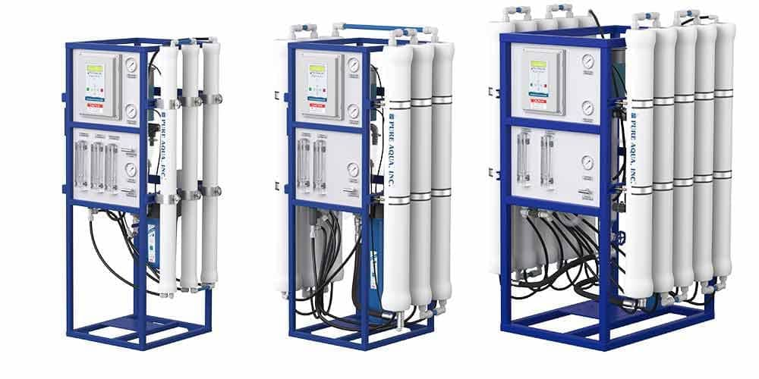
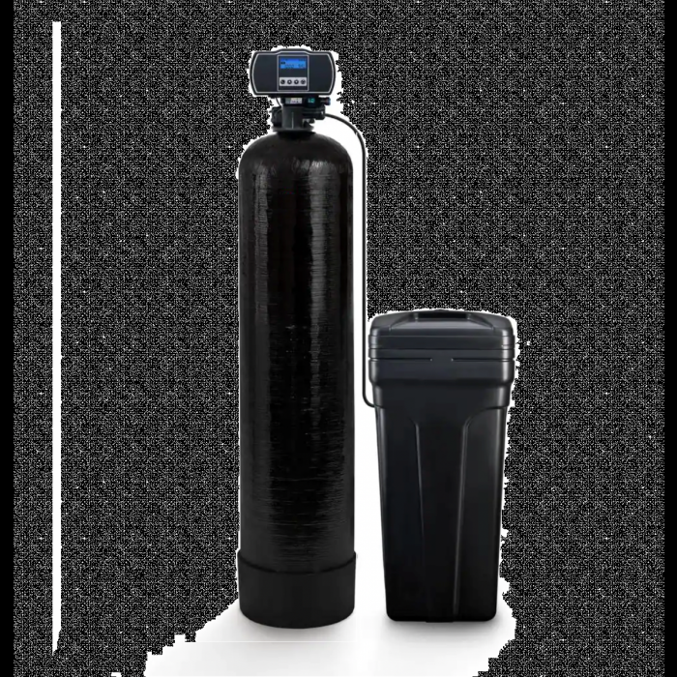
Water Quality
If you are in a hard water area, it is important to know your water quality. Check specs for:
  Dishmachine
  Water Heater
If necessary install:
  Water Softener
  RO system
Notes:
It is particularly important to know the water quality at your facility, as hard water can lead to a whole host of problems for many pieces of equipment. At the water heater, it can lead to cracked heating elements and flame diverters. At the dishmachine, it can cause cracked elements and plugs in the exhaust system. This is especially problematic for heat recovery dishmachines, as their heat exchangers can foul, which can prevent the machine from meeting its final rinse temperature.
Major pieces of equipment should have allowable hardness limits on their specifications sheets. If the hardness in your area is higher than the limits for the dishmachine and water heater, it may be necessary to install a water softening system or a reverse osmosis system.
Es particularmente importante conocer la calidad del agua en su establecimiento, ya que el agua dura puede causar problemas para muchas piezas de equipo. Puede provocar elementos calefactores y desviadores de llama agrietados en su calentador de agua. Puede causar elementos y tapones agrietados en el sistema de escape de su lavavajillas. Esto es especialmente problemático para lavavajillas con recuperación de calor, ya que sus intercambiadores de calor pueden ensuciarse, lo que puede evitar que la máquina alcance su temperatura de enjuague final.
Los principales equipos deben tener límites de dureza permitidos en sus hojas de especificaciones. Si la dureza en su área es mayor que los límites para la máquina lavavajillas y el calentador de agua, puede ser necesario instalar un sistema de ablandamiento de agua o un sistema de ósmosis inversa.

Slide 18
Section 2: Operation
Notes:
Section 2: Operation

Slide 19
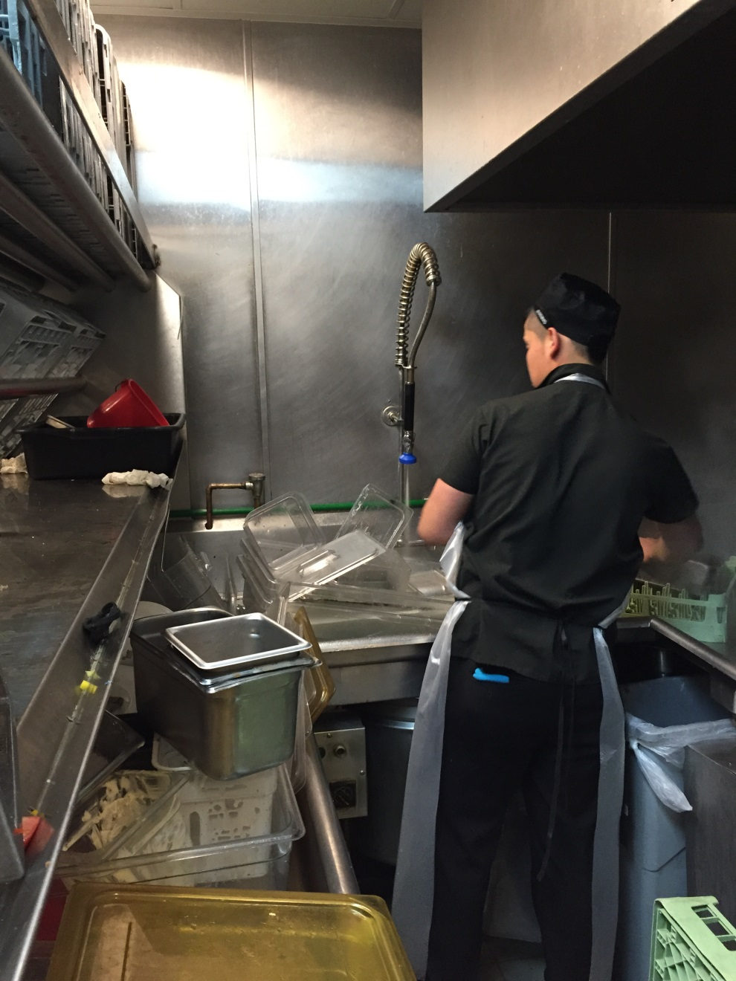
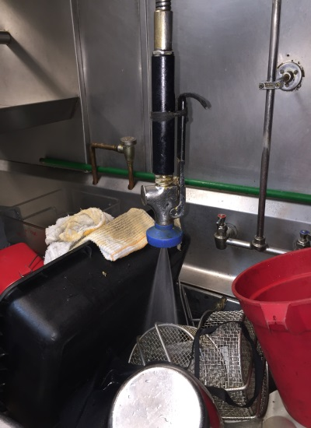
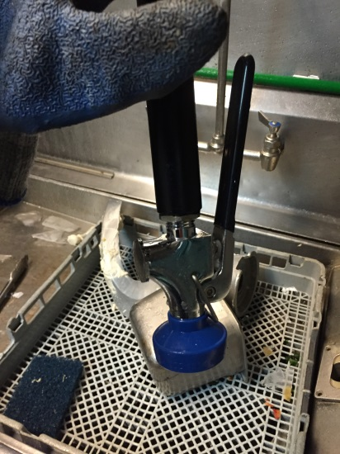
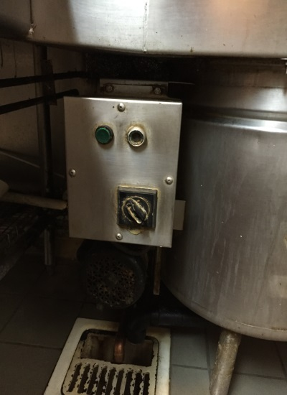
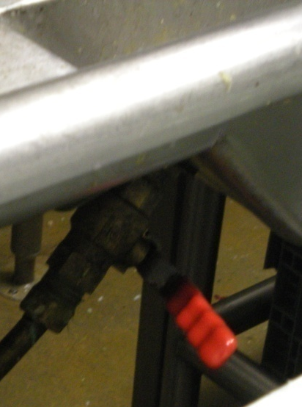
Train Staff on Operational Efficiency
Replace damaged equipment
Enable Controls and Train Staff
Notes:
Dishroom staff should be trained on the proper operation of all dishroom equipment, and should be encouraged to point out equipment that has a change in its operating pattern. Staff can be the first line of defense for saving hot water and for replacing damaged equipment.
El personal debe recibir capacitación sobre el funcionamiento adecuado de todo el equipo del área de lavado de platos y a notar cualquier cambio en el patrón de funcionamiento del equipo. El personal puede ser la primera línea de defensa para ahorrar agua caliente y para reemplazar equipos dañados.

Slide 20
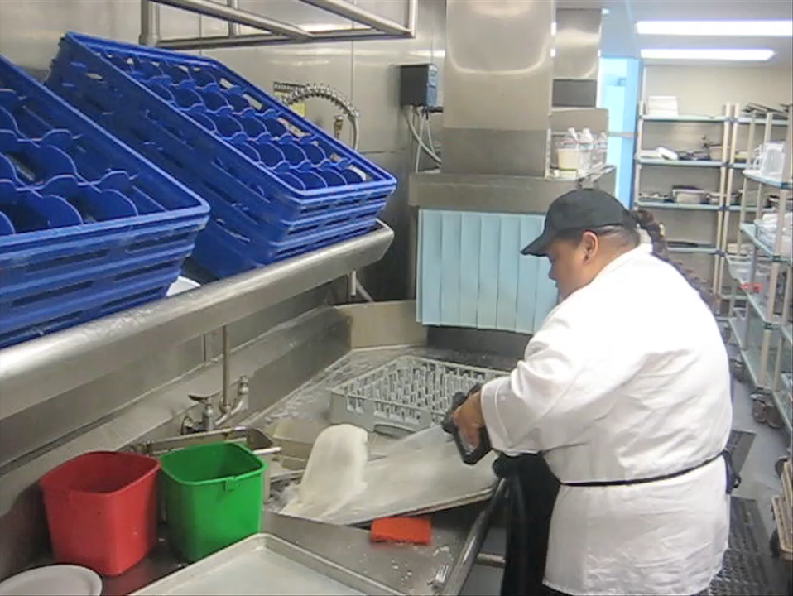
Poorly trained staff create water waste
Notes:
1 gpm freshwater for a scrapper with recirculation, 4 gpm rinse and carryover from dishwasher
In this video, a staff member is using a floor cleaning hose and a scrapper to pre-rinse a sheet pan before loading it into a dishmachine. Between the scrapper and the floor cleaning hose, there is over 5 gallons per minute of water usage even though there is a pre-rinse spray valve rated at less than a gallon per minute installed at this workstation. Additionally, the dishmachine is overspraying into the scrapper sink, indicating a maintenance problem that this staff member should report to management.
1 gpm de agua fresca para un raspador con recirculación, 4 gpm para enjuagar y sobrante del lavavajillas.
En este video, un empleado está utilizando una manguera de limpieza de suelos y un raspador para pre-enjuagar una bandeja antes de cargarla en el lavavajillas. Entre el raspador y la manguera de limpieza de suelos, hay más de 5 galones por minuto de uso de agua, a pesar de que hay una válvula de rociado de pre-enjuague con una capacidad de menos de un galón por minuto instalada en esta estación de trabajo. Además, el lavavajillas está rociando en exceso en el fregadero del raspador, lo que indica un problema de mantenimiento que este miembro del personal debería informar a los gerentes.

Slide 21
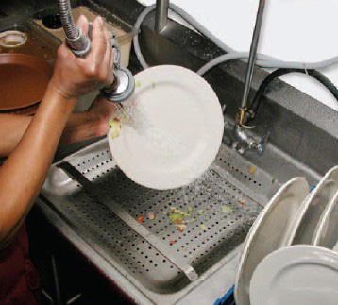
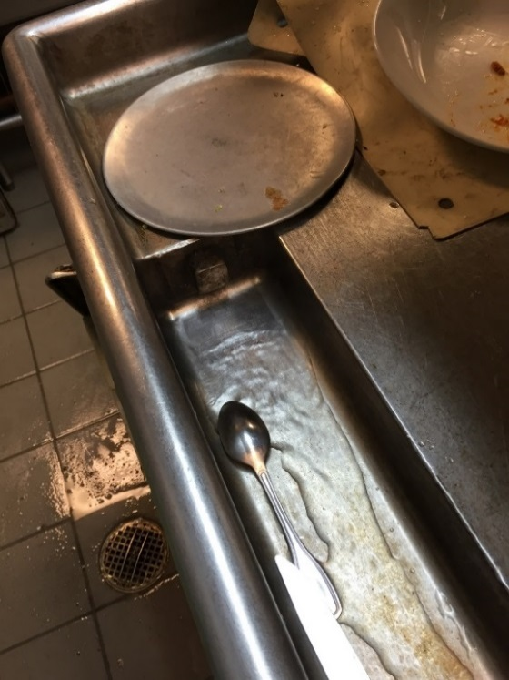
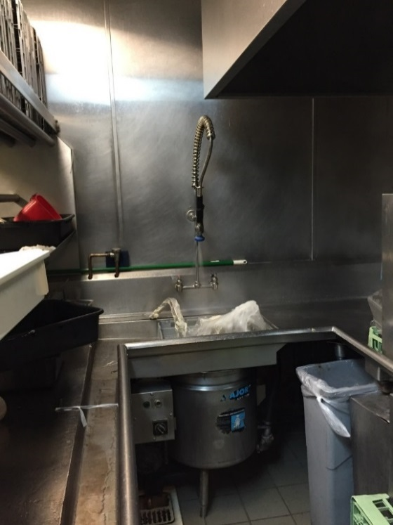
Pre-Rinse Operation Equipment
Pre-rinse sink is used in most dishrooms
Using a pre-rinse spray valve (PRSV) is the most common way that wares are rinsed prior to placement on racks or directly into dishmachine
Pre-Rinse Operation (PRO) is a combination of multiple practices including:
Pre-rinse sinks, dry scrapping
Food waste collectors
Disposers, scrapping troughs
Notes:
Pre-rinsing is the practice of removing food debris so that the dishwasher only has to sanitize the dishes. It is a critical step for the functioning operation of any dishroom.
A pre-rinse sink is used in most dishrooms. Pre-rinse spray valves are the most common piece of sanitation equipment found in most facilities. It is used to rinse stuck-on food debris from wares. Pre-rinse sprayers are intended to be used on wares after they have already been dry-scrapped, where staff has manually removed as much of the food debris as possible, either by hand or with a scrapping tool. Dry scrapping is the most important water-saving training measure for a facility. It is recommended that facilities have a dedicated dry-scrapping station with a compost-collecting bin and any scrapping tools near where dishes enter the dishroom.
Other pieces of equipment used for pre-rinsing are food waste collectors, disposers and scrapping troughs.
El pre-enjuague es la práctica de eliminar los residuos de alimentos para que el lavavajillas solo tenga que desinfectar los platos. Es un paso crítico para el funcionamiento adecuado de cualquier área de lavado de platos.
En la mayoría de las áreas de lavado de platos, se utiliza un fregadero de pre-enjuague. Las válvulas de rociado de pre-enjuague son el equipo de saneamiento más común que se encuentra en la mayoría de las instalaciones. Se utilizan para enjuagar los restos de alimentos pegados en la vajilla. Los rociadores de pre-enjuague están destinados a usarse en utensilios después de que ya hayan sido raspados en seco, donde el personal haya eliminado manualmente la mayor cantidad de residuos de alimentos posible ya sea a mano o con una herramienta de raspado. El raspado en seco es la medida de capacitación más importante para ahorrar agua en una instalación. Se recomienda que las instalaciones tengan una estación dedicada de raspado en seco con un contenedor para recoger estiércol vegetal y cualquier herramienta de raspado cerca de donde ingresan los platos al área de lavado de platos.
Otros equipos utilizados para el preenjuague son recolectores de residuos de alimentos, trituradores y canaletas de raspado.

Slide 22

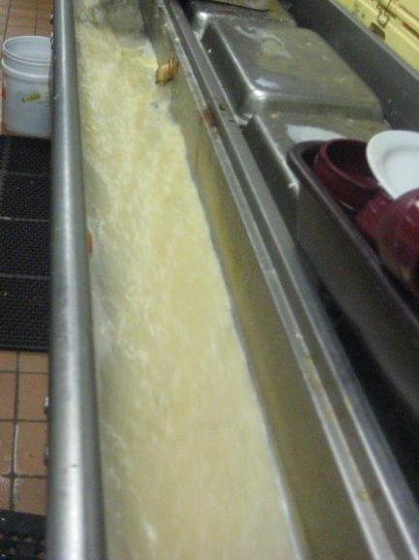
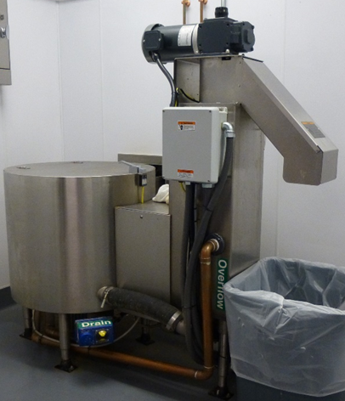
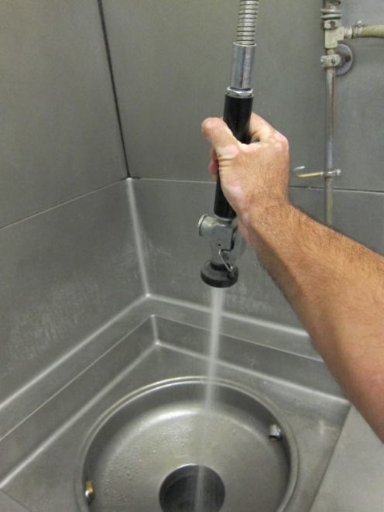
Common Types of Cafeteria Style PRO
Scrap Collector:
1 - 2 gpm of fresh water
8-30 gpm recirculated
Typically cold water
Sometimes tempered
Alternative to disposers
Can be on timer
Disposers:
3 - 10 gpm of fresh water
Low duration operation
Typically cold water
Water flow modulation based on waste load
Can be on timer
Trough to Disposer, Scrapper or Pulper:
2 - 3 gpm fresh water
5 - 15 gpm recirculated
Typically tempered water
Notes:
Restaurants typically have pre-rinse sprayers as their only form of pre-rinsing, but cafeterias can have some heavier duty equipment.
Scrap collectors use 1 to 2 gallons per minute of fresh water to create an 8 to 30 gallon per minute recirculated waterfall. These can and should be on timers to limit their water use.
Disposers usually use between 3 and 10 gpm of fresh water. They are essentially upgraded versions of the under-sink garbage disposers installed at many residential kitchen sinks, but they have a dedicated water inlet instead of depending on the sink’s water to clear chopped up food from the blades.
Troughs are essentially a river of tepid water running through the dishroom. Staff dunks dishwares in the trough to scrap them. They typically use between 2 and 3 gpm of fresh water.
Los restaurantes suelen tener rociadores de pre-enjuague como su única forma de pre-enjuagar, pero las cafeterías pueden contar con equipos más robustos.
Los recolectores de residuos utilizan de 1 a 2 galones por minuto de agua fresca para crear una cascada recirculada de 8 a 30 galones por minuto. Estos deben tener temporizadores para limitar su uso de agua.
Los trituradores suelen utilizar entre 3 y 10 galones por minuto de agua fresca. Son básicamente versiones mejoradas de los trituradores de basura instalados debajo del fregadero en muchos fregaderos de cocina residenciales, pero tienen una entrada de agua dedicada en lugar de depender del agua del fregadero para limpiar los restos de alimentos de las cuchillas.
Las canaletas son básicamente un río de agua tibia que atraviesa el área de lavado de platos. El personal sumerge los platos en la canaleta para rasparlos. Normalmente utilizan entre 2 y 3 galones por minuto de agua fresca.

Slide 23
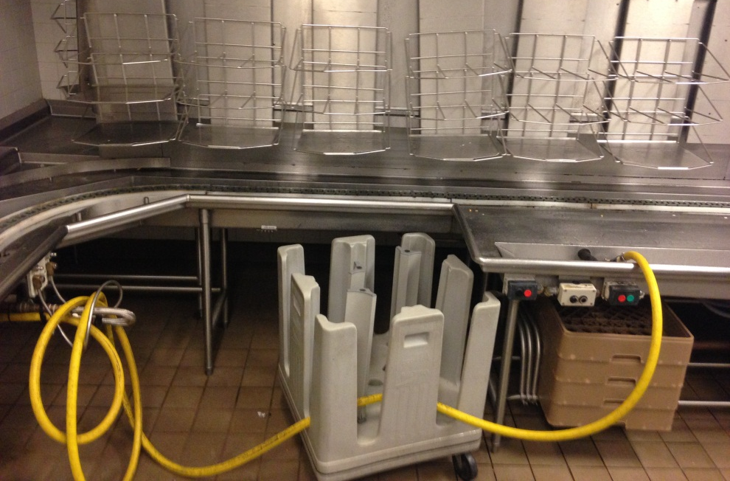
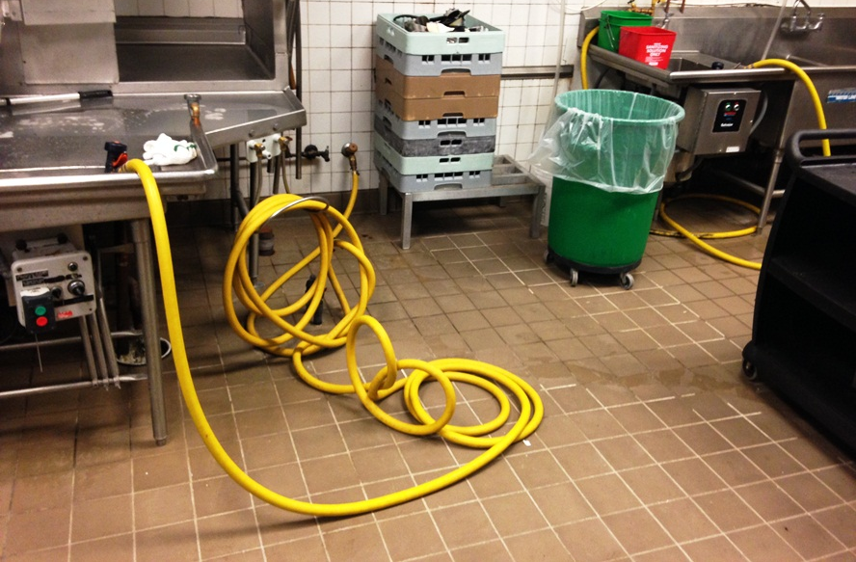
Data from a poorly performing field site
No pre-rinse spray valve assembly installed
Staff was dragging over industrial hoses used for floor cleaning, high flow rate of 5 to 7 gpm
3 Hoses used a total of 1,282 gal/d
2.1 hours of rinse operating time for 86”-rack conveyor
PRO Water Intensity is 623 gal/h
Notes:
Several generations of retrofits have happened in many of the kitchens on campus
e retrofits have happened, Design Thinking, after savings potential, the kitchen is designed poorly where floor cleaners, dishwashers, pre-rinse square ending of dishwasher, location, and observing how operators work. Even if a kitchen is designed well at a beginning, when equipment falls apart like conveyor system,…
The next few slides will cover data from a pre-rinse operations field study where about 20 cafeteria dishrooms were monitored for their water usage. This study can be found in the references section of the operator’s guide with the title “PRO Operations Field Comparison.”
Dishrooms can sometimes be intense places to work. Wares must get clean quickly to ensure the proper operation of other parts of the restaurant. Staff on the cookline can’t cook without clean implements and patrons can’t eat from dirty plates. Sometimes, when equipment malfunctions, the dishroom staff need to get creative, which can lead to misuse of equipment.
At one cafeteria monitored for this field study, engineers found that staff resorted to using industrial floor-cleaning hoses for want of a properly functioning trough, disposer and pre-rinse sprayer. Each hose had a flow rate between 5 and 7 gpm and used almost 1,300 gallons of water per day for pre-rinsing alone. Had the equipment been properly installed and functioning, the pre-rinse water usage would have been about 300 gallons per day, meaning that poorly trained staff and faulty equipment caused 1,000 gallons of water waste daily.
Han ocurrido varias generaciones de renovaciones en muchas de las cocinas del campus. La cocina está diseñada de manera deficiente en cuanto a la ubicación de limpiadores de suelos, lavavajillas, el extremo cuadrado del pre-enjuague del lavavajillas, la ubicación y la observación de cómo trabajan los operadores. Incluso si una cocina está bien diseñada al principio, cuando el equipo se deteriora, como el sistema de transporte...
Los próximos slides cubrirán datos de un estudio de campo sobre operaciones de pre-enjuague donde se monitorearon alrededor de 20 comedores para su consumo de agua. Este estudio se puede encontrar en la sección de referencias de la guía del operador con el título "Comparación de Campo de Operaciones de PRO".
Las áreas de lavado de platos a veces pueden ser lugares intensos para trabajar. Los platos deben limpiarse rápidamente para garantizar el buen funcionamiento de otras partes del restaurante. El personal en la línea de cocina no puede cocinar sin ollas y sartenes limpias, y los clientes no pueden comer en platos sucios. A veces, cuando el equipo falla, el personal de lavado de platos necesita ser creativo, lo que puede llevar al uso indebido del equipo.
En un comedor monitoreado para este estudio de campo, los ingenieros descubrieron que el personal recurría al uso de mangueras industriales de limpieza de suelos por falta de un canal, triturador y rociador de pre-enjuague en funcionamiento adecuados. Cada manguera tenía un caudal entre 5 y 7 galones por minuto y utilizaba casi 1,300 galones de agua al día solo para el pre-enjuague. Si el equipo se hubiera instalado y funcionado correctamente, el consumo de agua para el pre-enjuague habría sido de aproximadamente 300 galones al día, lo que significa que el personal mal capacitado y el equipo defectuoso causaron un desperdicio de agua de 1,000 galones diarios.

Slide 24
Summary of Pre-Rinse and Dishmachine Operations
PRO Method | PRO per hour Dishmachine Rinse (gal/h_rinse) | Dishmachine per hour Rinse (gal/h_rinse) | Dishwasher and PRO Per Hour of Rinse (gal/h_rinse) | PRO as Percentage of Total
Dry Scrapping | 0 | 143 | 143 | 0%
Dry Scrapping | 0 | 223 | 223 | 0%
Scrapper with PRSV | 18 | 243 | 262 | 7%
Disposer with PRSV | 40 | 414 | 454 | 9%
Disposer with PRSV | 127 | 164 | 292 | 44%
3 Industrial Hoses and Rinse Valves | 623 | 667 | 1289 | 48%
Scrapper with PRSV | 841 | 367 | 1208 | 70%
Cold Water Hose with No Valve | 985 | 1711 | 2696 | 37%
Data is all over the place
Equipment and operating practices have a huge impact
Water and energy intensity in the dishroom can vary by 20X
Notes:
The example from the last slide was not the worst performing site in this study and was far from the only example where equipment was misused and proper procedures were not followed.
This table shows the average water usage from the pre-rinse method at each site. The most efficient method for pre-rinse operations was dry-scrapping, but a scrapper installed with a pre-rinse spray valve was also very efficient. The main takeaways from this study were that operating practices can have a huge impact on dishroom water and energy usage, and that dry-scrapping can save a lot of water.
The most water waste from this study came from sites where equipment was mis-used. The other main takeaway from this study was that training staff on the proper operation of dishroom equipment and incentivizing them to report malfunctioning equipment can prevent this waste.
El ejemplo del último slide no fue el sitio con peor rendimiento en este estudio y está lejos de ser el único ejemplo donde se mal utilizó el equipo y no se siguieron los procedimientos adecuados.
Esta tabla muestra el consumo promedio de agua del método de pre-enjuague en cada sitio. El método más eficiente para las operaciones de pre-enjuague fue el pre-enjuague en seco, pero un raspador instalado con una válvula de rociado de pre-enjuague también fue muy eficiente. Las principales conclusiones de este estudio fueron que las prácticas operativas pueden tener un gran impacto en el consumo de agua y energía en el área de lavado de platos, y que el pre-enjuague en seco puede ahorrar mucha agua.
El desperdicio de agua más significativo en este estudio provino de sitios donde se mal utilizó el equipo. La otra conclusión principal de este estudio fue que capacitar al personal sobre el manejo adecuado del equipo de lavado de platos e incentivarlos a informar sobre el equipo defectuoso puede prevenir este desperdicio.

Slide 25
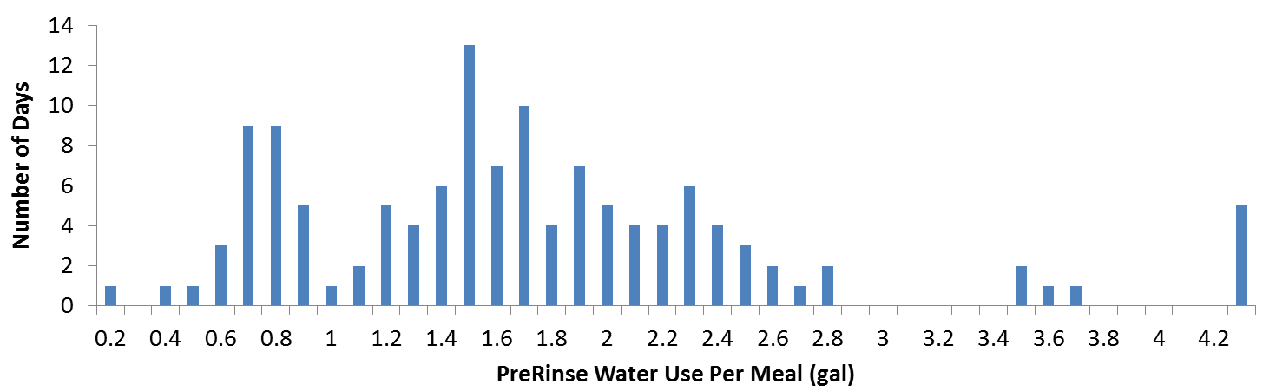
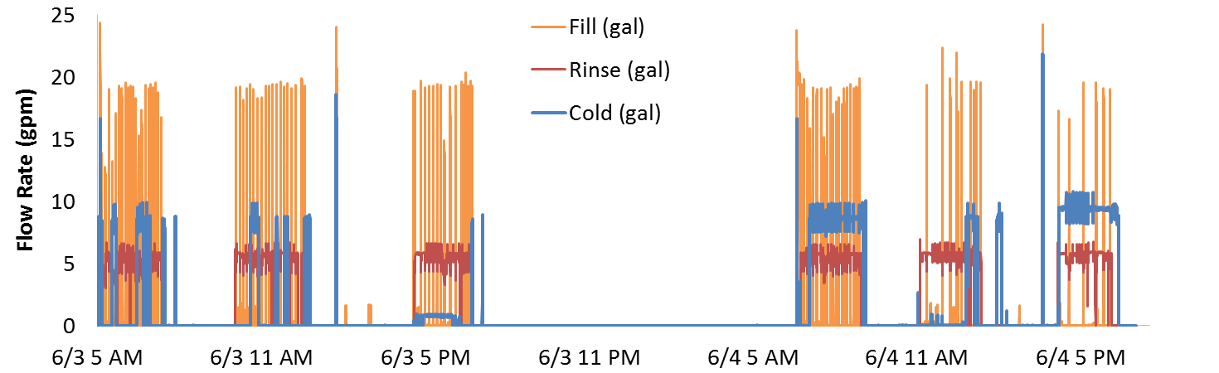
Pre-Rinse Water Use Per Meal
6/3
6/4
1.0 g/m
0.8 g/m
0.3 g/meal
4.2 g/m
1.1 g/m
5.9 g/m
20X More Water Use Per Meal
Notes:
This data comes from a field study where the pre-rinse equipment at a large cafeteria was monitored for its water usage. The top graph shows how often the average daily pre-rinse water use per meal reached certain thresholds. On June third, it averaged 0.7 gallons per meal. On June fourth, it averaged 3.6 gallons per meal. The cafeteria did not have any change in its equipment, so the only real change that could have affected the water consumption was the staff’s operating pattern.
The bottom graph shows the average water use per meal period. For breakfast on June third, water use averaged 1.0 gallon per meal. Lunch averaged 0.8 gallons per meal, and dinner averaged 0.3 gallons per meal. In contrast, breakfast on June fourth averaged 4.2 gallons per meal, lunch averaged 1.1 gallons per meal and dinner averaged 5.9 gallons per meal. Between dinner on June third and dinner on June fourth, water use increased by a factor of 20. Staff during the dinner period on the third focused much more on dry scrapping and only sparsely used a pre-rinse spray valve to provide pre-rinsing whereas staff during the dinner period on the 4th misused floor cleaning equipment and disabled the recirculating function of the scrapper and trough.
Estos datos provienen de un estudio de campo donde se monitoreó el uso de agua del equipo de pre-enjuague en una gran cafetería. El gráfico superior muestra con qué frecuencia el uso promedio diario de agua de pre-enjuague por comida alcanzaba ciertos umbrales. El 3 de junio, promedió 0.7 galones por comida. El 4 de junio, promedió 3.6 galones por comida. La cafetería no tuvo cambios en su equipo, por lo que el único cambio real que podría haber afectado el consumo de agua fue el patrón operativo del personal.
El gráfico inferior muestra el uso promedio de agua por período de comida. Para el desayuno el 3 de junio, el uso de agua promedió 1.0 galón por comida. El almuerzo promedió 0.8 galones por comida, y la cena promedió 0.3 galones por comida. En cambio, el desayuno el 4 de junio promedió 4.2 galones por comida, el almuerzo promedió 1.1 galones por comida y la cena promedió 5.9 galones por comida. Entre la cena del 3 de junio y la cena del 4 de junio, el uso de agua aumentó en un factor de 20. El personal durante el período de la cena del tercer día se enfocó mucho más en el raspado en seco y usó solo esporádicamente una válvula de rociado de preenjuague para proporcionar el preenjuague, mientras que el personal durante el período de la cena del 4to día malutilizó equipos de limpieza de pisos y deshabilitó la función de recirculación del raspador y la canal.

Slide 26
A Proper Training Program Includes:
Standard start-up and shut-down procedures for all equipment
Standard operating procedures for all equipment
Designation of a clean and a dirty zone in the dish room
Daily cleaning schedules and procedures for all equipment
Close of shift/facility shut-down procedure
An incentive to report malfunctioning equipment to management

Slide 27
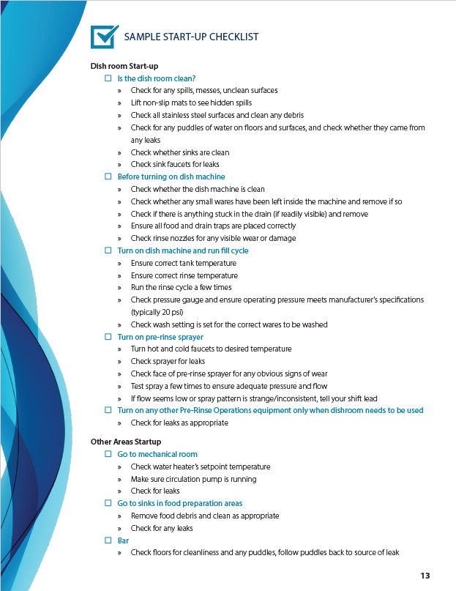
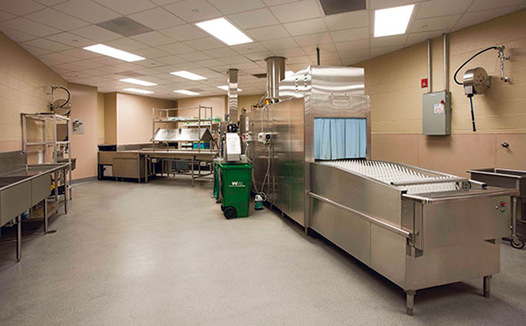
Notes:
The next few slides include sample checklists for startup and shutdown of a commercial foodservice facility.

Slide 28
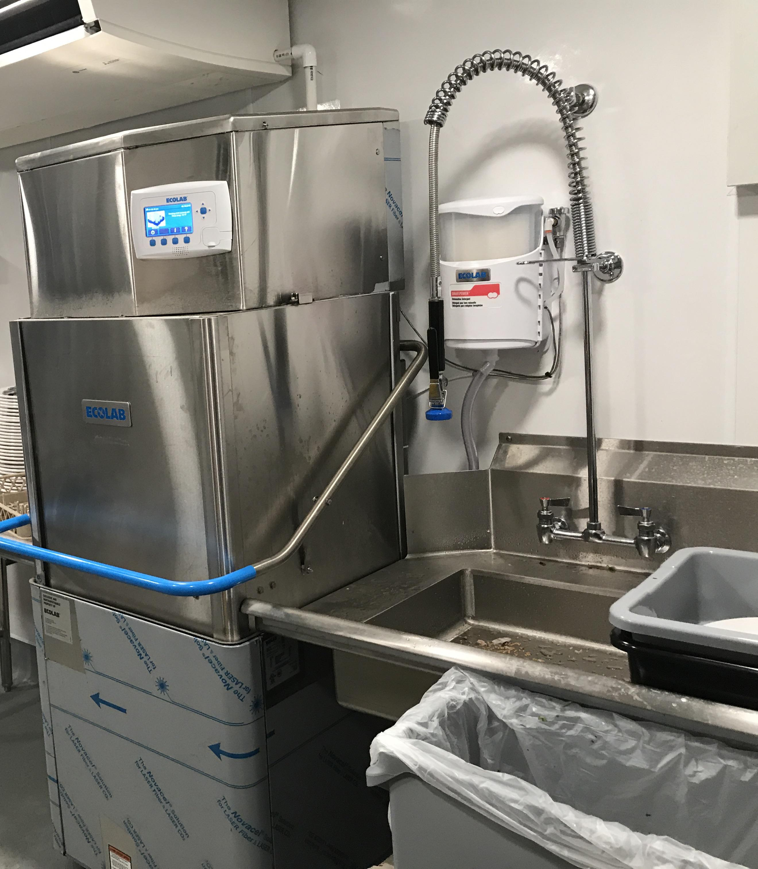
Notes:
A copy of this checklist is included as a pdf at the end of this presentation.

Slide 29
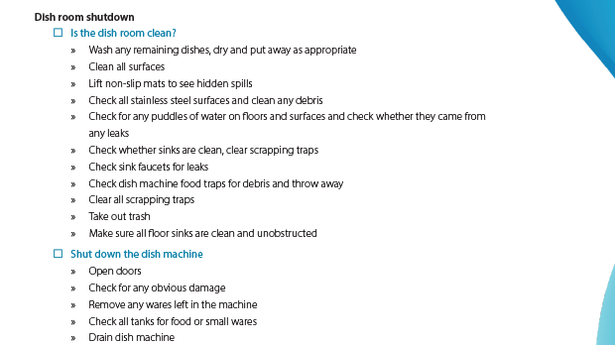
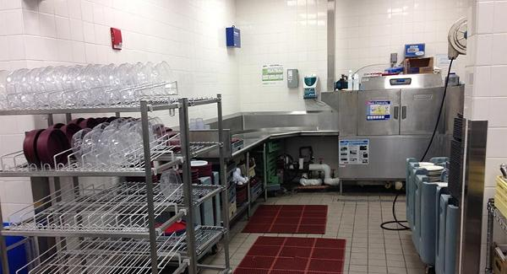

Slide 30
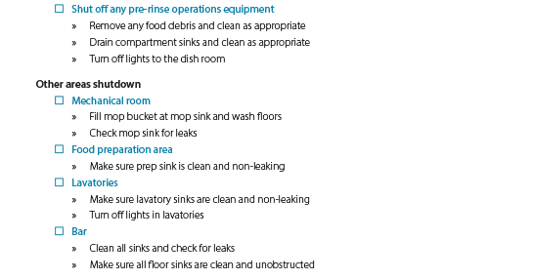
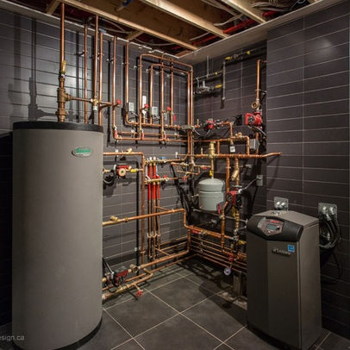

Slide 31
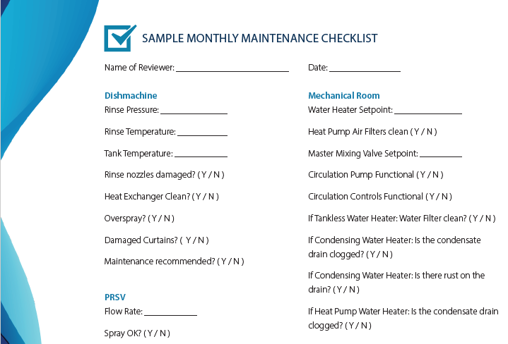
Notes:
Finally, a monthly maintenance checklist should be followed by management once per month. This should include places where performance data from major equipment can be recorded and yes/no questions to remind the reviewer to check everything on the list. In addition to the items on the sample list provided here and as a pdf at the end of this presentation is to perform a water softener or water quality check. The water quality entering the hot water system should be checked to ensure that it is below the allowable limits for the water heater and dishmachine.
Finalmente, los gerentes deben seguir una lista de verificación de mantenimiento mensual una vez al mes. Esto debe incluir lugares donde se puedan registrar datos de rendimiento de equipos importantes y preguntas de sí/no para recordar al revisor que verifique todo en la lista. Además de los elementos en la lista de muestra proporcionada aquí y como un PDF al final de esta presentación, se debe realizar una verificación del suavizador de agua o de la calidad del agua. La calidad del agua que ingresa al sistema de agua caliente debe verificarse para asegurarse de que esté por debajo de los límites permitidos para el calentador de agua y el lavavajillas.

Slide 32
Section 3: Maintenance
Notes:
Section 3: Maintenance

Slide 33
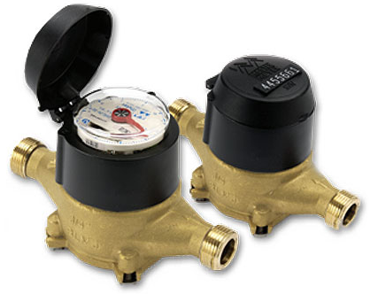
Six Steps to Maintain Equipment
1. Listen to Staff
2. Check your utility metering data
3. Identify and immediately address leaks
Leak Type | Leak Size (gpm) | Cost per Year
Quickly dripping compartment sink faucet | 0.1 | $26
Disposer recirculation starting to get clogged | 0.25 | $64
Stuck-open dishmachine drain | 0.4 | $103
Failed-open Pre-Rinse Spray Valve | 0.5 | $129
Notes:
There are six main steps to keeping hot water systems maintained. Step 1 is to listen to staff. Especially if they’ve been incentivized to report operating problems to management, they should be able to help to quickly identify equipment that needs to be maintained or replaced. They’re the people handling the equipment, so they’ll be the quickest to identify problems. Step 2 is to check utility metering data. This will be especially useful if the utility provides smart metering data where minute by minute or hour by hour data can be easily accessed. But even keeping a record of water use over time can be helpful in identifying bigger problems. If this month’s water usage was higher than last months and there wasn’t a significant uptick in the number of meals served, this can be a cause for concern and further investigation. Step three is to identify and immediately address leaks in any fixtures and the hot water piping. The table below shows the cost per year of various sizes of leaks. Part of the start up and shut down procedures should be to check for leaks.

Slide 34
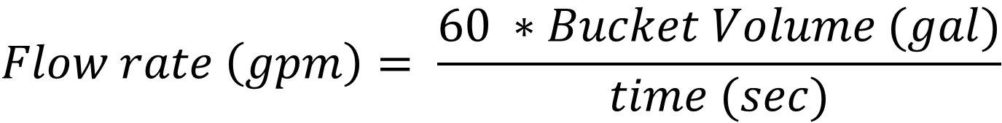
Six Steps to Maintain Equipment (cont.)
4. Identify burnt-out pre-rinse equipment
5. Identify when dishwashers need maintenance
6. Follow a maintenance and replacement schedule
$$Flow rate \left(gpm\right)= \frac{60 ∗Bucket Volume (gal)}{time (sec)}$$
Notes:
Step 4 is to identify burnt out pre-rinse equipment. Making sure pre rinse spray valves are operating adequately and making sure scrappers and troughs are recirculating properly are important steps for preventing hot water waste. Any automatic shutoff devices such as occupancy sensors installed on any equipment should also be checked periodically. When burnt-out equipment is identified, the operator should dhave that piece of equipment replaced as soon as possible.
Step 5 is to identify when dishwashers need maintenance. It can sometimes be difficult to identify operating problems with dishwashers, but common visible problems are overspray, where water sprays from the washing compartment onto the dish loading tables, leaks, and worn-out rinse curtains on conveyor machines.
Step 6 is to follow a maintenance and replacement schedule. Sample maintenance and replacement schedules are provided in the next slides.

Slide 35
Sample Maintenance Schedule
Fixture | Model Number | Technician Contact Information | Monthly Maintenance Checks | Tune Up Time Period
Dishmachine | MFR-HTDEHR-180-42 | Frank Fixer (XXX)XXX-XXXX | Rinse Temperature, Tank Temperature, Rinse Pressure, Rinse Flow Rate | Two Months
Pre-Rinse Spray Valve | MFR-PRSV-08G | Frank Fixer (XXX)XXX-XXXX | Rinse Flow Rate | N/A
Scrapper | MFR-SCRP-120 | Joe Plumber (XXX)XXX-XXXX | Drain Flow Rate | Six Months
Recirculation Pump | MFR-CIRC-42 | Joe Plumber (XXX)XXX-XXXX | Is it making any weird noises? | On Burnout
Recirculation Controller | MFR-CTRL-99 | Joe Plumber (XXX)XXX-XXXX | Does it turn off when it’s supposed to? Recirculation temperature when the pump is running | Upon perceived problem
Water Heater | MFR-WH-200 | Joe Plumber (XXX)XXX-XXXX | Outlet Temperature/Setpoint | Three Months
Notes:
This is a sample maintenance schedule. The information that should be included on maintenance schedules is a list of each fixture and its make and model information, the contact information for the service technician, a list of maintenance checks to be performed by the operator, and the tune-up time period. It is also important to keep a maintenance log for each piece of equipment, which should include the date of the last service and what repairs were performed.
Este es un ejemplo de calendario de mantenimiento. La información que debe incluirse en los calendarios de mantenimiento es una lista de cada accesorio y su información de marca y modelo, la información de contacto del técnico de servicio, una lista de verificaciones de mantenimiento a realizar por el operador y el período de ajuste. También es importante mantener un registro de mantenimiento para cada equipo, que debe incluir la fecha del último servicio y qué reparaciones que han hecho.

Slide 36
Sample Replacement Schedule
Fixture | Model Number | Installation Date | Technician Contact Information | Expected Burnout Date | Date To Specify and order New Machine
Dishmachine | MFR-HTDEHR-180-42 | 1/1/2020 | Frank Fixer (XXX)XXX-XXXX | 1/1/2027 | 7/1/2026
Pre-Rinse Spray Valve | MFR-PRSV-08G | 1/1/2020 | Frank Fixer (XXX)XXX-XXXX | 1/1/2021 | 7/1/2020
Scrapper | MFR-SCRP-120 | 1/1/2020 | Joe Plumber (XXX)XXX-XXXX | 1/1/2024 | 7/1/2023
Recirculation Pump | MFR-CIRC-42 | 1/1/2020 | Joe Plumber (XXX)XXX-XXXX | 1/1/2024 | 7/1/2023
Recirculation Controller | MFR-CTRL-99 | 1/1/2020 | Joe Plumber (XXX)XXX-XXXX | 1/1/2024 | 7/1/2023
Water Heater | MFR-WH-200 | 1/1/2020 | Joe Plumber (XXX)XXX-XXXX | 1/1/2026 | 7/1/2025
Notes:
This is a sample replacement schedule. The most important information on this chart is the installation date, the date of expected burnout and the date to specify and order a new machine. Dishmachines have expected lifespans of about 7 years, pre-rinse sprayers have expected lifespans around a year, and most other fixtures have expected lifespans between four and six years. It is generally a good practice to specify a new machine about six months before the expected burnout date.
Este es un ejemplo de programa de reemplazo. La información más importante en este gráfico es la fecha de instalación, la fecha de esperado agotamiento y la fecha para especificar y ordenar una nueva máquina. Las lavavajillas tienen una esperanza de vida de aproximadamente 7 años, las rociadoras de prelavado tienen una esperanza de vida de alrededor de un año, y la mayoría de los otros accesorios tienen esperanzas de vida entre cuatro y seis años. En general, es una buena práctica especificar una nueva máquina aproximadamente seis meses antes de la fecha esperada de agotamiento.

Slide 37
Section 4: Retrofitting and Replacing

Slide 38
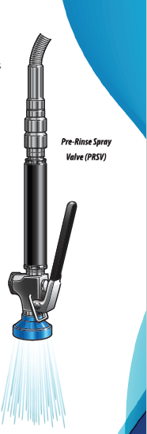
Pre-Rinse Operating Equipment
Easiest to achieve savings through retrofit
Common flow rate at 1.2 gpm
Do:
  Install multiple PRSV in larger facilities
  Replace PRSV frequently
  Dry scrap as much as possible
Do not:
  Use floor hoses instead of PRSV
  Drill out scaled-over PRSV
  Mis-use scrappers, disposers, troughs
Notes:
Pre-rinse sprayers are the easiest fixture to replace, both in terms of the ease of installation of a new sprayer and the cost of the sprayer itself. Pre-rinse spray nozzles are usually available for less than 100 dollars and can usually be swapped out by an operator without the need for a service technician.
Because common pre-rinse sprayers have flow rates around 1.2 gallons per minute and efficient pre-rinse sprayers have flow rates around 0.7 gallons per minute, these fixtures also offer significant water and energy savings upon replacement.
Some design and operating best practices are to install multiple pre-rinse spray valves in larger facilities, as this allows more staff to pre-rinse dishware during busy periods, to replace pre-rinse spray valves frequently to ensure an efficient dishroom operation, and to train staff to dry scrap as much as possible, as this will further reduce water and energy use.
If staff is trained poorly and encounter scaled-over or otherwise poorly performing pre-rinse sprayers, they may use floor hoses instead of pre-rinse sprayers or attempt to drill out the scaled over nozzle. Floor hoses have typical flow rates around ten gallons per minute, and drilling out the scaled over nozzle can increase the sprayer’s flow rate to as high as five gallons per minute. Replacement is cheap and easy, and is a much better option than mis-using equipment.
Los rociadores de prelavado son el accesorio más fácil de reemplazar, tanto en términos de la facilidad de instalación de un nuevo rociador como en el costo del propio rociador. Los cabezales de rociado de prelavado suelen estar disponibles por menos de $100 y generalmente se pueden cambiar sin necesidad de un técnico de servicio.
Dado que los rociadores de prelavado comunes tienen tasas de flujo de alrededor de 1.2 galones por minuto y los rociadores de prelavado eficientes tienen tasas de flujo de alrededor de 0.7 galones por minuto, estos accesorios también ofrecen ahorros significativos de agua y energía al ser reemplazados.
Algunas prácticas recomendadas de diseño y operación son instalar varios cabezales de rociado de prelavado en instalaciones más grandes, ya que esto permite que más personal pre-lave la vajilla durante los períodos ocupados, reemplazar con frecuencia los cabezales de rociado de prelavado para garantizar un funcionamiento eficiente de la sala de lavado y capacitar al personal para eliminar la comida seca tanto como sea posible, ya que esto reducirá aún más el uso de agua y energía.
Si el personal recibe una capacitación deficiente y se encuentra con cabezales de rociado de prelavado cubiertos de escamas u otros que funcionan mal, pueden usar mangueras de piso en lugar de rociadores de prelavado o intentar perforar el cabezal cubierto de escamas. Las mangueras de piso suelen tener tasas de flujo típicas de alrededor de diez galones por minuto, y perforar el cabezal cubierto de escamas puede aumentar la tasa de flujo del rociador hasta cinco galones por minuto. El reemplazo es barato y fácil, y es una opción mucho mejor que el uso incorrecto del equipo.

Slide 39
Continuous Recirculation Systems
For recirculation systems, install recirculation controllers:
  Save 95% of the gas used to operate recirculation system
  Allow storage water heaters to operate at higher efficiency
Easy retrofit option is a smart-plug style controller
Notes:
Operators who have recirculation systems should consider installing recirculation controllers. They can save up to 95% of the gas used to operate the recirculation system and also allow storage water heaters to operate at a higher efficiency, saving energy. There are smart-plug style controllers that are particularly easy to install.
Los operadores que tienen sistemas de recirculación deberían considerar la instalación de controladores de recirculación. Pueden ahorrar hasta un 95% del gas utilizado para operar el sistema de recirculación y también permitir que los calentadores de agua de almacenamiento funcionen a una mayor eficiencia, ahorrando energía. Hay controladores de estilo “smart” que son particularmente fáciles de instalar.

Slide 40
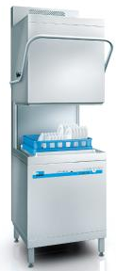
Dishmachines
Specify heat recovery dishmachines on burnout
Consider footprint, table layout, water pressure in dishroom, electric capacity in the dishroom
Machine | Racks per day | Cost per Rack | Annual Operating Cost
Conventional | 227 | $0.17 | $14,200
ENERGY STAR | 247 | $0.15 | $12,500
Heat Recovery Dishmachine | 201 | $0.12 | $11,000
Notes:
Operators should specify exhaust heat recovery dishmachines on burnout. The table below shows results from a field study where a conventional high temperature door type dishmachine was replaced with an energy star machine, then a heat recovery machine. The heat recovery machine outperformed the conventional and energy star machines, saving the operator about $3,200 in the process.
When specifying a retrofit dishmachine, the operator needs to consider the new machine’s footprint and the loading and unloading table layout. The operator should check on the retrofit machine’s specifications sheet to ensure that the new machine is compatible with the previous setup. If this is not done, tables may need to be replaced, which can dramatically increase the cost of installing the replacement machine. The operator should also check the water pressure and electrical capacity in the dishroom to make sure that the new dishmachine is compatible with the current setup. A common problem when switching from a low-temperature rinse dishmachine to a high temperature rinse dishmachine is that there is not enough power in the dishroom to operate the new machine, and an electrician needs to run a new electrical line from the main breaker.
Los operadores deberían especificar lavavajillas con recuperación de calor en caso de agotamiento. La tabla a continuación muestra resultados de un estudio de campo donde se reemplazó un lavavajillas de tipo puerta de alta temperatura convencional con una máquina con certificación ENERGY STAR y luego con una máquina de recuperación de calor. La máquina de recuperación de calor superó a las máquinas convencionales y con certificación ENERGY STAR, ahorrándole al operador aproximadamente $3,200 en el proceso.
Al especificar un lavavajillas de sustitución, el operador debe considerar la huella de la nueva máquina y el diseño de la disposición de las mesas de carga y descarga. El operador debe revisar la hoja de especificaciones de la máquina de sustitución para asegurarse de que sea compatible con la configuración anterior. Si esto no se hace, es posible que se deban reemplazar mesas, lo que podría aumentar drásticamente el costo de instalar la máquina de reemplazo. El operador también debe verificar la presión del agua y la capacidad eléctrica en la zona de lavado para asegurarse de que la nueva máquina de lavavajillas sea compatible con la configuración actual. Un problema común al cambiar de un lavavajillas de enjuague a baja temperatura a uno de enjuague a alta temperatura es que no hay suficiente potencia en la zona de lavado para operar la nueva máquina, y un electricista debe instalar una nueva línea eléctrica desde el interruptor principal.

Slide 41
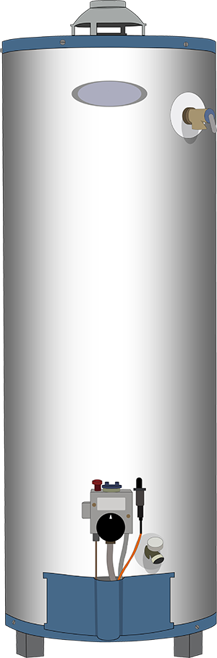
Standard Efficiency Storage
Pros
Simple
Robust
Low cost
Easy to specify
Easy to fix
Easy to replace
$2-9K
Cons
80% TE
Standby loss (100 gallon unit): 1000 – 1300 Btu/h
Can run out of hot water
Short life in certain commercial kitchen environments ~5y
Notes:
The first step in selecting a water heater for a commercial foodservice facility once the rest of the system is designed is to select the kind of water heater that is desired. The most common water heater type is the standard efficiency natural gas fed water heater. The pros are that these heaters are simple, robust, low cost, easy to specify, easy to fix, easy to replace and relatively cheap with an upfront cost between 2 and 9 thousand dollars depending on the size of the heater and how much storage it has. The cons are that it only has an 80% thermal efficiency, they can have significant standby losses, they can run out of hot water especially if they’re undersized, and they have a short lifespan in commercial kitchen environments around five years.

Slide 42
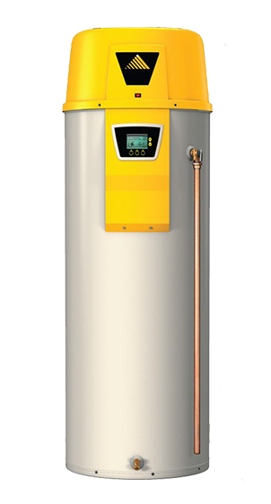
High Efficiency (Condensing) Storage
Pros
Condensing
95% efficiency
Standby loss: 600 – 1000 Btu/h
Potentially lower cost of install due to PVC exhaust
Pairs well with MMV
Cons
More complex
Manage Condensate
Not the standard
Higher first cost
Can run out of hot water
Short life in certain commercial kitchen environments
Notes:
Condensing water heaters are more efficient than standard storage water heaters. They work by running extra lengths of exhaust through the water tank. This cools the exhaust and allows the water in the combustion exhaust to condense, which provides more heat to the water in the tank.
The pros are…
The cons are…
Los calentadores de agua de condensación son más eficientes que los calentadores de agua de almacenamiento estándar. Funcionan al hacer pasar longitudes adicionales de escape a través del tanque de agua. Esto enfría el escape y permite que el agua en el escape de la combustión se condense, lo que proporciona más calor al agua en el tanque.
Las ventajas son...
Las desventajas son...

Slide 43
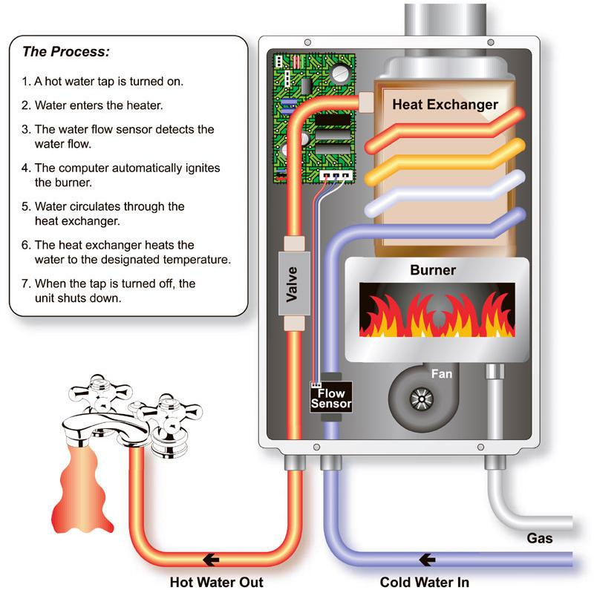
Tankless (On Demand)
Pros
Smaller footprint
Outside installation possible
No standby loss
Cons
Significant pressure drop
Minimum water flow limits
Each unit provides a water flow of approx. 4 gpm
Probably need several units
Higher gas inputs rates = higher installation costs
Increased maintenance required
Takagi Industrial Co. USA Inc.
Notes:
The cons are that they can cause a significant pressure drop. These water heaters have a control system which allows them to limit the outlet flow of hot water so that they can meet their temperature setpoint. If multiple large points of use are run at the same time, these units will starve the entire hot water system, which can lead to critical hot water failures.
Las desventajas son que pueden causar una caída significativa de presión. Estos calentadores de agua tienen un sistema de control que les permite limitar el flujo de agua caliente de salida para que puedan alcanzar su punto de ajuste de temperatura. Si varios puntos de uso grandes se están utilizando al mismo tiempo, estas unidades agotarán el agua en todo el sistema de agua caliente, lo que puede provocar fallas críticas en el suministro de agua caliente.

Slide 44
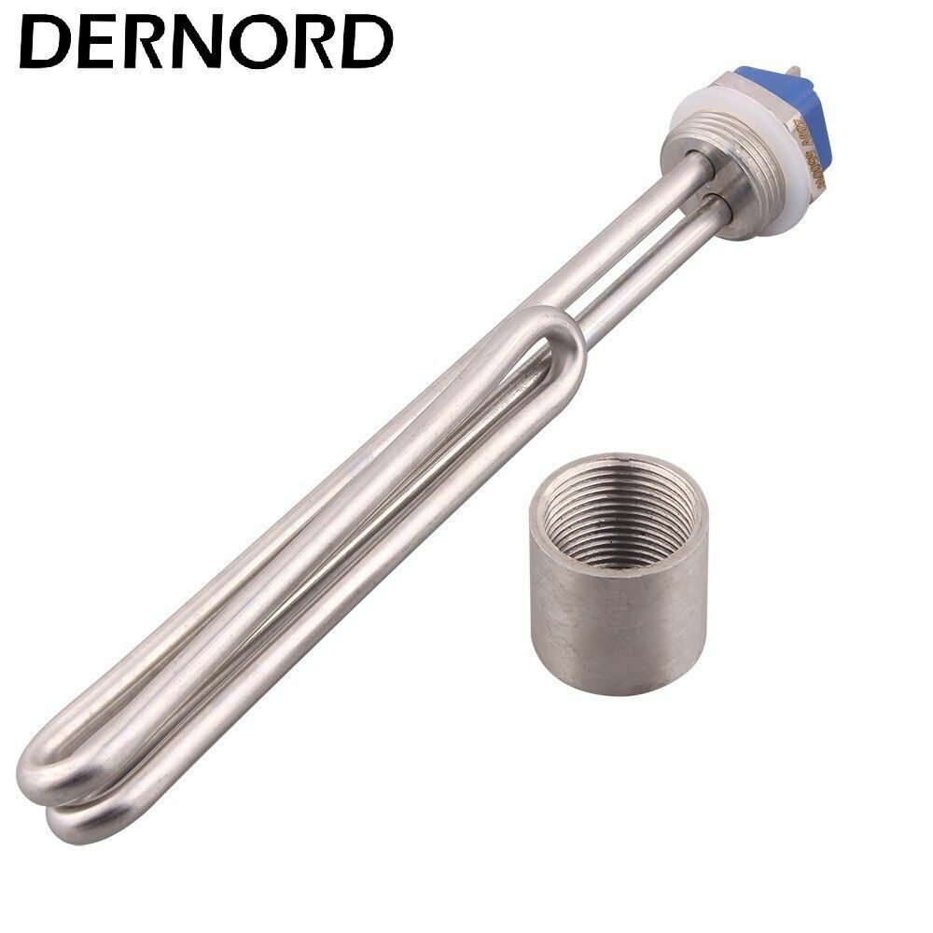
Electric Resistance Water Heaters
Cons
Large amperage draw requires large service panel
Significant energy use with more expensive fuel means that these heaters are much more expensive to run than ones fed with natural gas
Not a huge thermal efficiency gain over gas water heaters
Pros
ZNC/ Decarbonization Friendly
Simple
Notes:
Electric resistance water heaters are not very common in the commercial foodservice industry. The pros are that they are zero net carbon and decarbonization friendly. They are also simple and easy to work on. The cons are that they have a large amperage draw and can require a large service panel for commercial-kitchen sized loads. This would also lead to significant energy use with a more expensive fuel. This means that these heaters are more expensive to run than ones fed with natural gas of a similar size. Finally, there isn’t a huge thermal efficiency gain over gas water heaters. Gas water heaters have efficiencies around 80% and electric resistance heaters have efficiencies around 95%, so the efficiency gain isn’t enough to offset the difference in fuel costs.

Slide 45
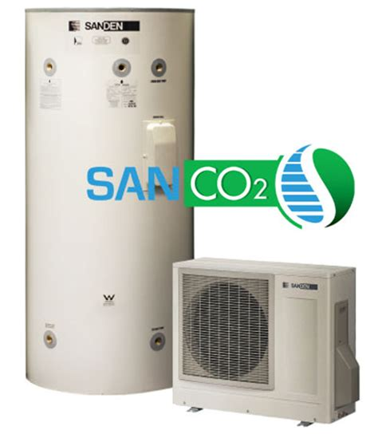
Heat Pump Water Heaters
Pros
Possible to size exactly for the load
Coefficient of Performance
  Gas: COP = 1.8
  Electric: COP = 2.5
Free cooling can lead to A/C savings!*
Cons
Larger footprint
Slower recovery
Requires ventilation
2x cost of traditional WH
Notes:
If California continues to decarbonize, heat pump water heaters are likely to become the most common type of water heater in commercial foodservice facilities. Heat pump water heaters boast a coefficient of performance as opposed to a thermal efficiency. They siphon energy from the air in their surroundings to heat water. An electric Heat Pump Water Heater with a COP of 2.5 would produce 2.5 kWh of useful water heating for ever kWh consumed at the wall. This would provide very large energy savings over conventional gas water heaters and could, in some cases, be enough to offset the higher fuel cost.
Heat Pump water heaters can be packaged or split, which refers to whether the evaporator is connected to the hot water tank or remote. If the evaporator is placed in a hot room in a facility, the heat pump can provide some free cooling as an added benefit.
The cons are that these units require large volumes of hot water storage to compensate for their slower recovery, which means that they require a larger footprint. Heat Pump water heaters also require ventilation and have about twice the upfront cost of traditional water heaters, so there are significant barriers to their widespread adoption in the commercial foodservice industry.
Si California continúa descarbonizándose, es probable que los calentadores de agua tipo bomba de calor se conviertan en el tipo más común de calentador de agua en instalaciones comerciales de servicios de alimentos. Los calentadores de agua tipo bomba de calor cuentan con un coeficiente de rendimiento en lugar de una eficiencia térmica. Extraen energía del aire circundante para calentar agua. Un calentador de agua eléctrico tipo bomba de calor con un coeficiente de rendimiento de 2.5 produciría 2.5 kWh de calentamiento de agua útil por cada kWh consumido en la pared. Esto proporcionaría ahorros de energía muy significativos en comparación con los calentadores de agua a gas convencionales y, en algunos casos, podría ser suficiente para compensar el mayor costo del combustible.
Los calentadores de agua tipo bomba de calor pueden ser empaquetados o divididos, lo que se refiere a si el evaporador está conectado al tanque de agua caliente o si está ubicado de forma remota. Si el evaporador se coloca en una habitación caliente de una instalación, la bomba de calor puede proporcionar algo de enfriamiento gratuito como un beneficio adicional.
Las desventajas son que estas unidades requieren grandes volúmenes de almacenamiento de agua caliente para compensar su recuperación, lo que significa que necesitan un mayor espacio. Los calentadores de agua tipo bomba de calor también requieren ventilación y tienen aproximadamente el doble del costo inicial de los calentadores de agua tradicionales. Por esas razones lo que existen barreras significativas para su adopción generalizada en la industria de servicios de alimentos comerciales.

Slide 46
Key Takeaways
√ The first step to running an efficient hot water system is making sure your system is commissioned properly
√ Staff should be trained in efficient use of hot water system equipment, especially the practice of dry scrapping as much as possible
√ Daily startup and shutdown procedures save water and energy and also prevent mechanical failures of devices
√ Staff should be trained to be the first line of defense in reporting mechanical problems
√ Regular and frequent maintenance should be performed on all major fixtures
√ Equipment lifespans should be planned for, and replacements at end-of-life shouldn’t be an emergency upon burnout

Slide 47
Thank you!
For more information please contact:
Adelagah@trccompanies.com
mslater@frontierenergy.com

